Slide 1

Customer Churn Prediction Project
Understanding why customers leave is crucial for any business. This project delves into customer behavior to identify patterns leading to churn, enabling proactive retention strategies.

Slide 2



What is Customer Churn?
Definition
Impact
Prediction
Customer churn refers to the phenomenon where customers stop using a company's product or service, often switching to a competitor.
High churn rates can significantly impact revenue, growth, and brand reputation. Retaining existing customers is often more cost-effective than acquiring new ones.
By analyzing historical data, we can predict which customers are at risk of churning, allowing businesses to intervene before it's too late.

Slide 3
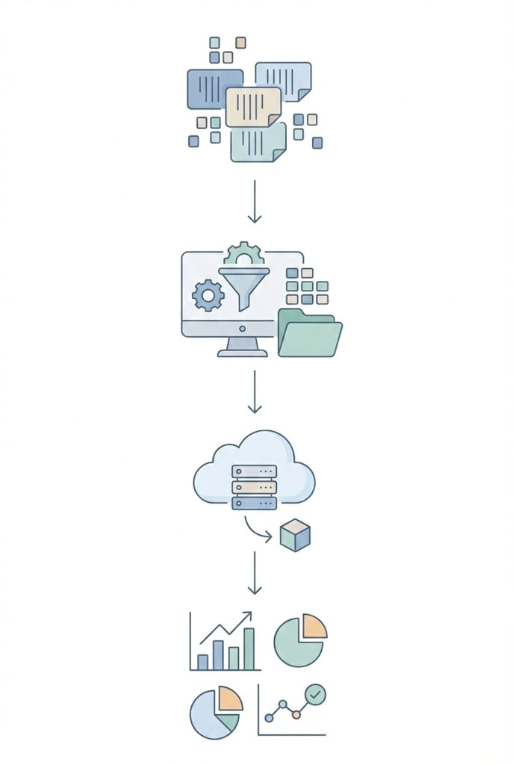




Project Workflow: From Data to Actionable Insights
Our project follows a structured approach, transforming raw customer data into predictive models and actionable business intelligence.
EDA/ETL
Model Building
Deployment
Insights

Slide 4
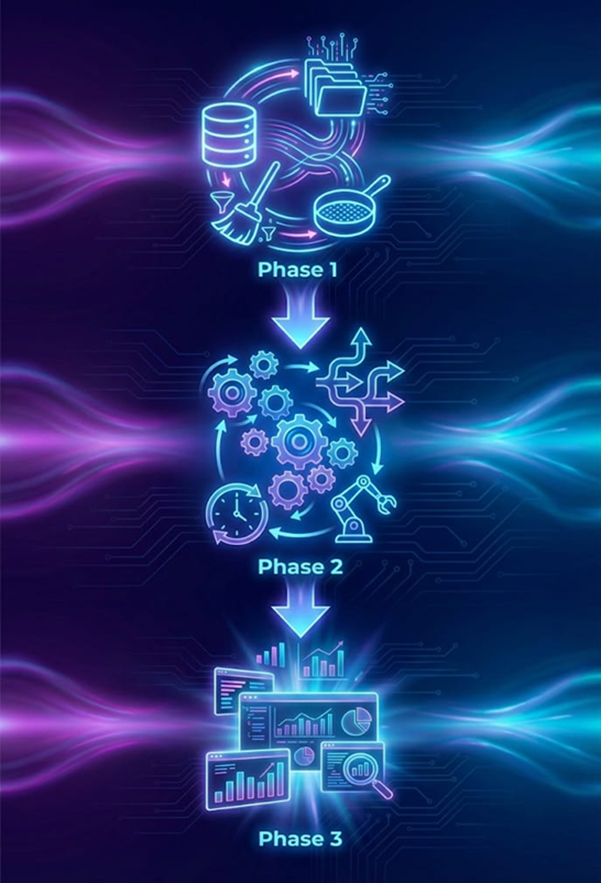
Three Phases of Our Pipeline
1
Phase 1: Data Preparation
Extract, Load & Clean Data for Analysis
2
Phase 2: Orchestration
Pipeline Orchestration & Scheduling
3
Phase 3: Visualization
Insights & Visualization with Power BI
Each phase was meticulously executed, leveraging specialized skills within our team to ensure robust and reliable results.

Slide 5
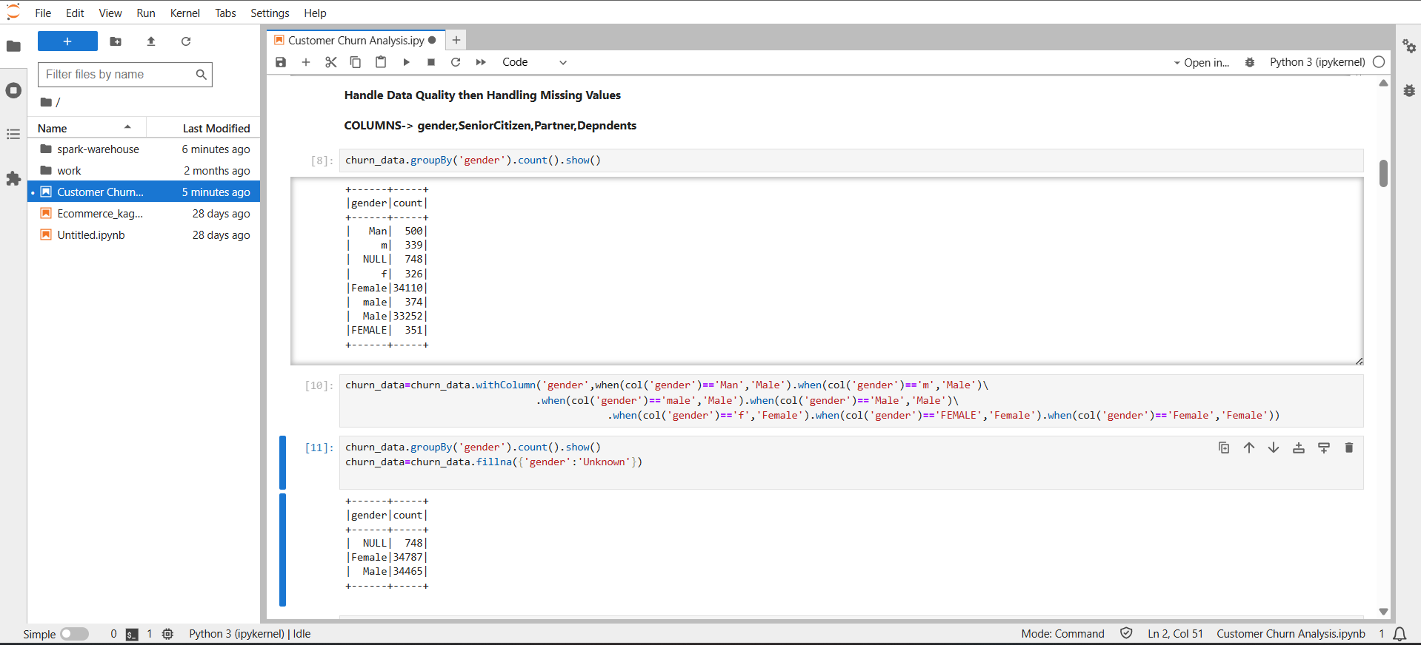
Phase 1: Data Preparation
Standardizing Categorical Values and Handling Missing Gender Data
This section shows the process of cleaning and unifying inconsistent gender entries in the dataset. Variations such as “Man,” “m,” and different spellings of “Female” were standardized into clear categories. Remaining missing values were then filled with “Unknown” to ensure a clean and reliable dataset for analysis
Concept: Data Warehousing & Star Schema
A Data Warehouse (DWH) is a central repository of integrated data from one or more disparate sources, used for reporting and data analysis. A Star Schema is a specific type of DWH schema with a central fact table connected to multiple dimension tables. It optimizes query performance for analytical workloads.

Slide 6
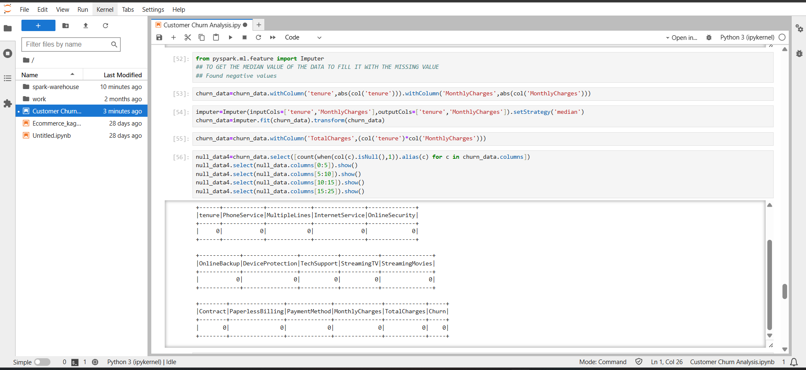
Missing Values Check and Data Preprocessing
The image shows a key step in the data preprocessing phase of the Customer Churn analysis project. In this stage, negative values in numerical columns like tenure and MonthlyCharges are corrected, and the PySpark Imputer is used to fill missing values using the median strategy. A new feature, TotalCharges, is then created by multiplying tenure by the monthly charges. The code also includes displaying the count of missing values for each column to ensure the dataset is clean and ready for further analysis or model building.
Concept: Data Warehousing & Star Schema
A Data Warehouse (DWH) is a central repository of integrated data from one or more disparate sources, used for reporting and data analysis. A Star Schema is a specific type of DWH schema with a central fact table connected to multiple dimension tables. It optimizes query performance for analytical workloads.

Slide 7
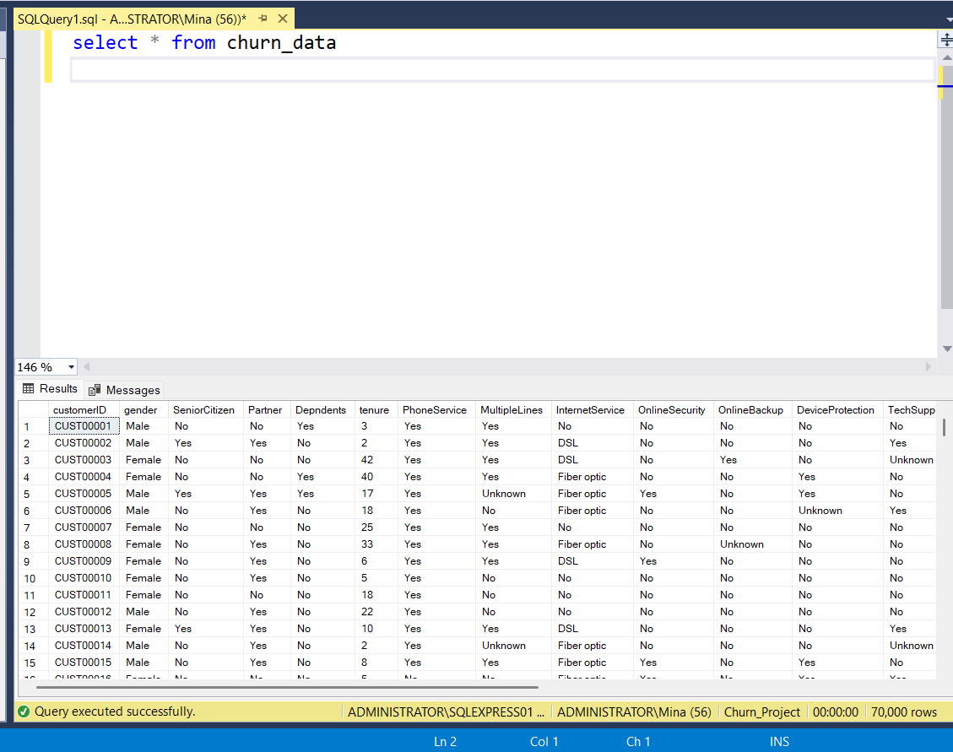
Phase 2: Pipeline Orchestration & Scheduling with Airflow
Exploring Customer Churn Data
This image shows the initial data view of the churn_data table in SQL Server, displaying key customer details like gender, tenure, and various service subscriptions. This foundational inspection is essential for understanding the dataset's structure before proceeding with advanced data analysis for churn prediction.
Concept: ETL & Orchestration
ETL (Extract, Transform, Load) is a process that extracts data from source systems, transforms it into a clean format, and loads it into a data warehouse. Orchestration refers to the automated configuration, coordination, and management of computer systems, applications, and services. Airflow excels at this, defining dependencies and handling failures.

Slide 8
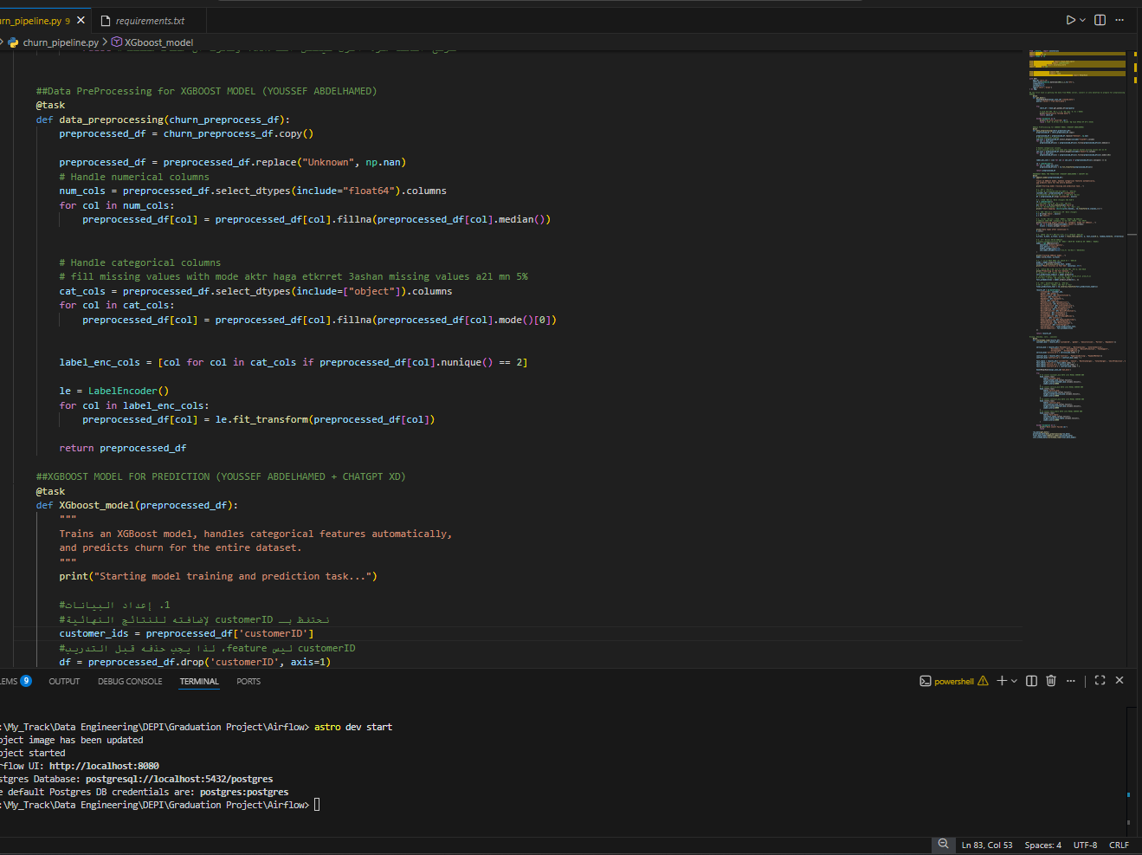
Data Preprocessing for Customer Churn Prediction
This Python script in VS Code demonstrates the initial steps of a machine learning workflow, including handling missing data and preprocessing features before training an XGBoost model for customer churn prediction.

Slide 9
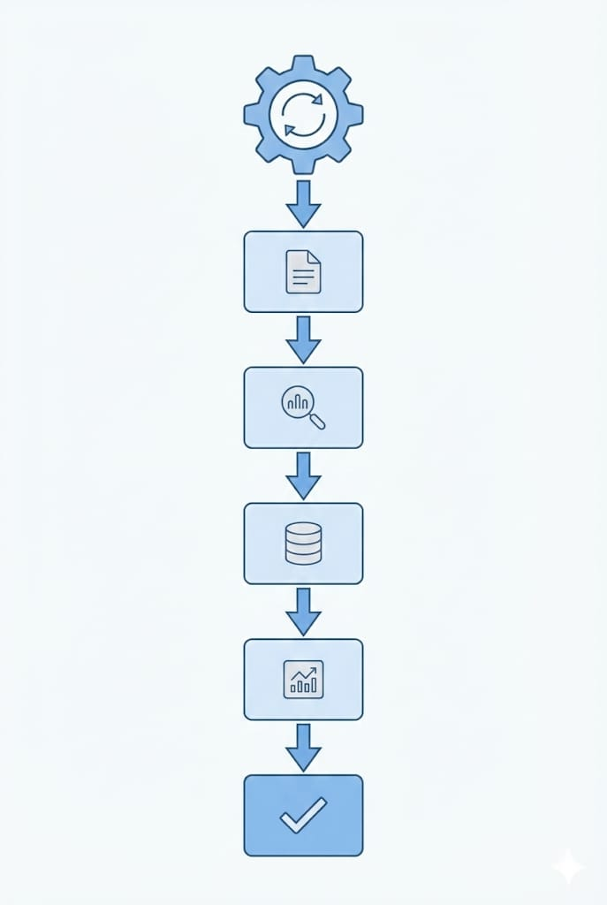
Airflow DAG: Automating Our Churn Pipeline
The `Airflow` folder contains our DAG definitions, outlining the sequence and dependencies of tasks in our data pipeline. This code defines how data is processed, models are trained, and results are prepared for visualization.
Code Implementation
The Python scripts within the `Airflow` folder represent individual tasks (e.g., data cleaning, feature engineering, model training) that are orchestrated by Airflow. Each task is defined with clear inputs and outputs, ensuring modularity and reusability.
Benefits of Airflow
Airflow provides robust scheduling, monitoring, and error handling capabilities. It ensures that our churn prediction model is always fed with fresh data and that insights are generated consistently.

Slide 10
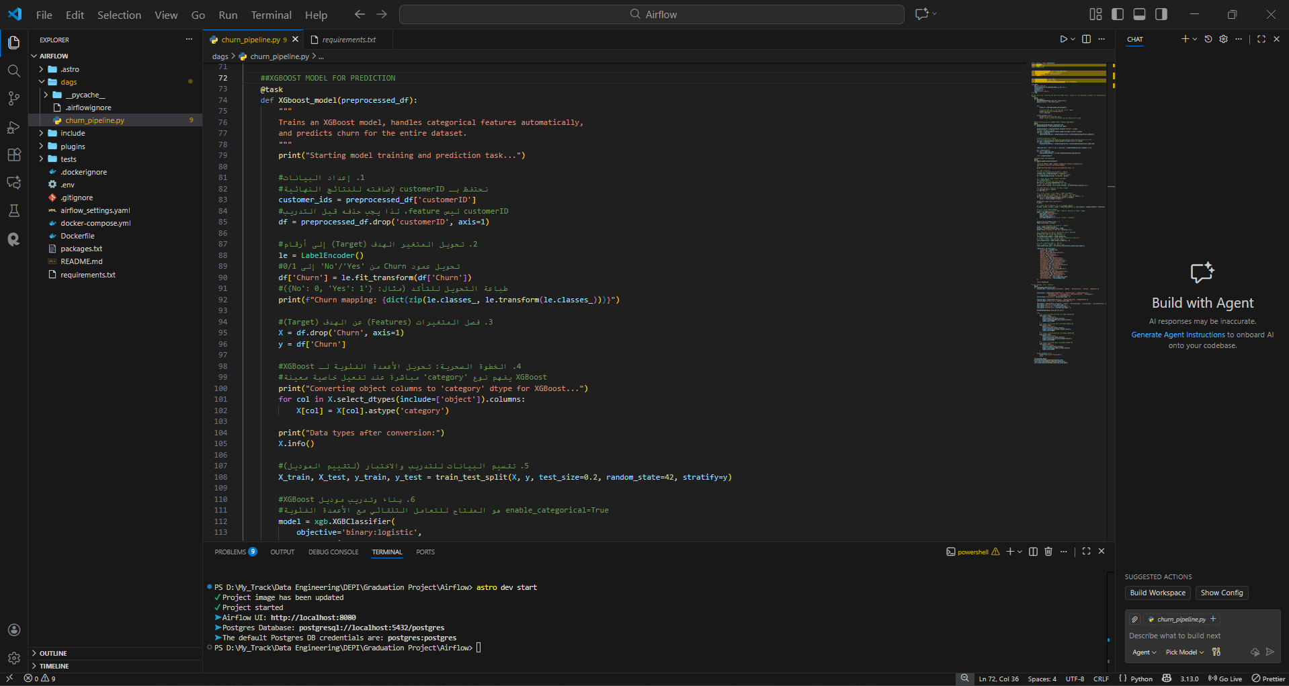
Advanced XGBoost Modeling for Churn Prediction
This Python code prepares the dataset for the final prediction stage by encoding the target variable ('Churn') and splitting the data for training and testing. It then initiates the XGBoost Classifier model for building a robust predictive solution.

Slide 11
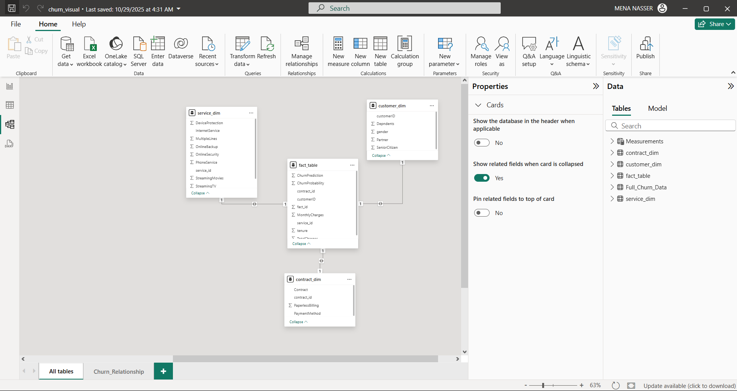
Implementing Data Modeling: The Star Schema
This screenshot illustrates the conceptual design of our Star Schema for churn analysis. The central fact table would contain key metrics, linked to dimension tables such as customer demographics, service usage, and transaction history.
Data Modeling
Data modeling is the process of creating a visual representation of either a whole or a part of an information system to communicate connections between data points and structures. It's crucial for designing efficient databases and data warehouses.

Slide 12
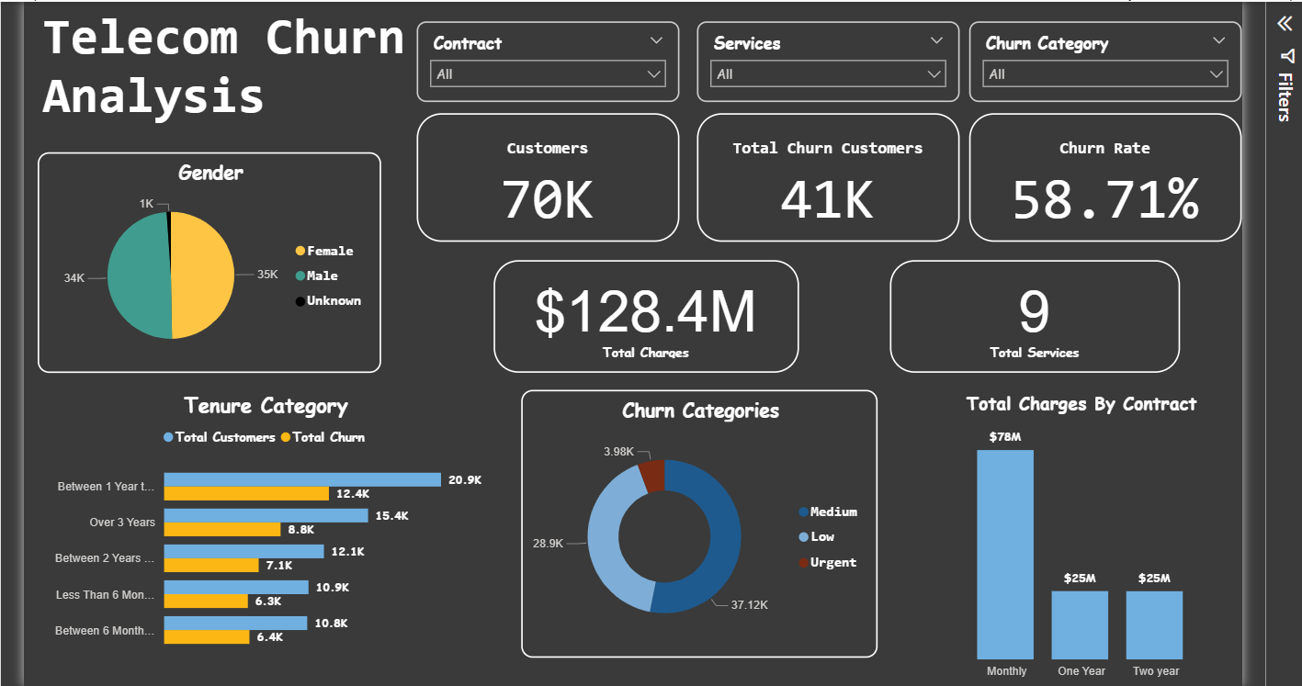
Phase 3: Insights & Visualization with Power BI
The final phase focuses on translating complex data and model predictions into intuitive, interactive dashboards. Our goal was to empower business users with clear, actionable insights to drive customer retention strategies.
Extracting Insights
Our Power BI dashboards allow stakeholders to explore churn trends, identify high-risk customer segments, and understand the factors contributing to churn. This visual approach facilitates quicker decision-making and more targeted retention efforts.

Slide 13

Conclusion: From Raw Data to Actionable Insights
Raw Data Input
Began with diverse, unrefined customer transaction and interaction data.
Data Transformation
Cleaned, structured, and modeled data into a robust Star Schema.
Automated Processing
Leveraged Airflow for reliable and scalable ETL and model training.
Predictive Modeling
Built a classification model to identify high-risk churn customers.
Actionable Insights
Delivered interactive Power BI dashboards for strategic decision-making.
This pipeline has significantly improved data quality, automated processing workflows, and provided invaluable business understanding, enabling proactive customer retention strategies.

Slide 14
Thank you

